Slide 1
Lariat Fleet Optimization for 2019
Eli Steinbeck
6/1/2021

Slide 2
Optimize How Exactly?
Increasing Revenue
Decreasing Costs
Maintain 2018 Vehicle Count and:
Strategy 1 – Replace the lowest revenue generating vehicles.
Strategy 2 – Replace the costliest vehicles.
Strategy 3 – Replace the lowest profit generating vehicles.
2018 Snapshot
Vehicle Count | 4000
Annual Revenue | $61,219,794*
Annual Cost | $33,076,689
Annual Profit | $28,143,105*
*Annual values are a projected estimate based on data available from January-October 2018.

Slide 3
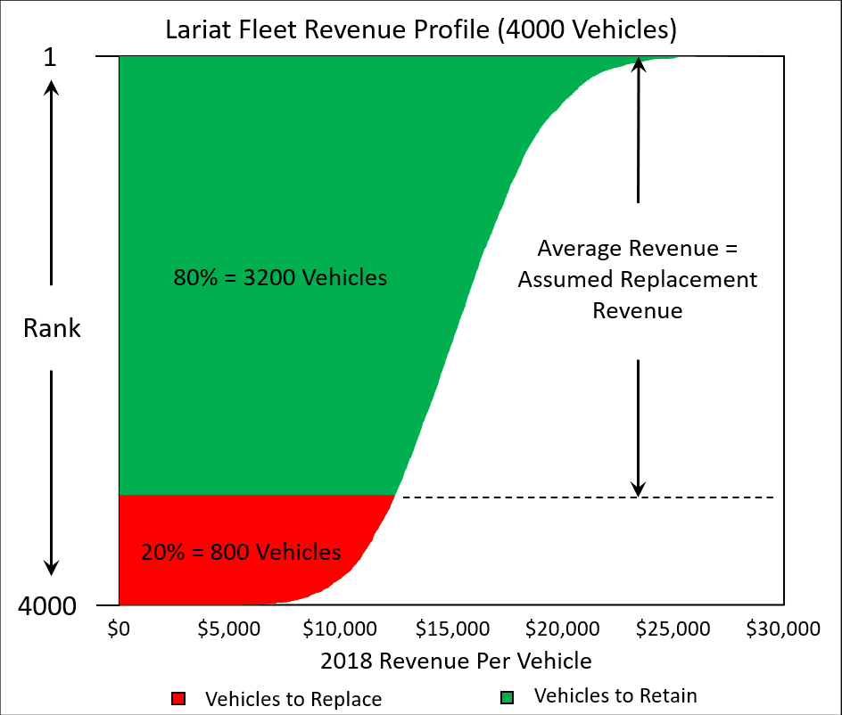
Modeling Setup
Objective: Identify the poorest performing vehicles in Lariat’s fleet in terms of revenue, cost, and profit.
Main Goal: Determine the best replacement strategy to optimize Lariat’s 2019 fleet.

Slide 4
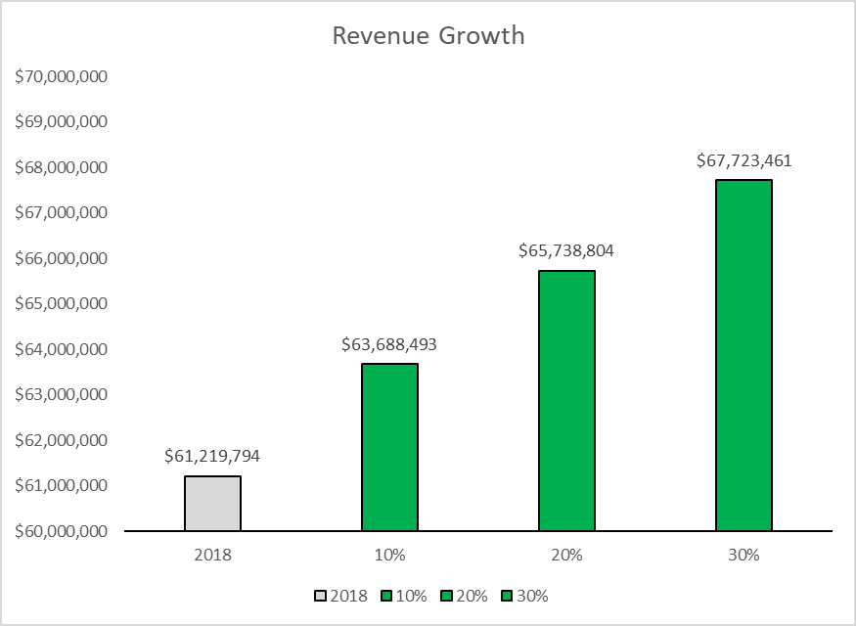
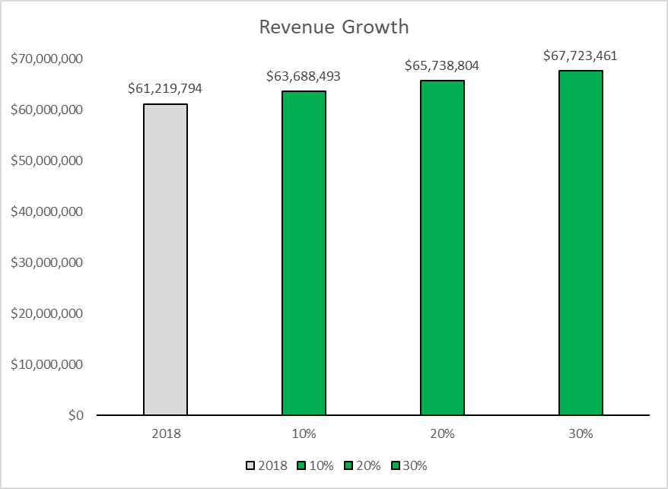
Modeling Results (Strategy 1)
2018 Revenue ≈ $61,200,000
Assuming Lariat replaces 20% of the fleet:
2019 Additional Revenue ≈ $4,500,000
Revenue Growth Rate
≈ 7.5%
2018
(Baseline)
10%
20%
30%
Percent of Fleet to Replace

Slide 5
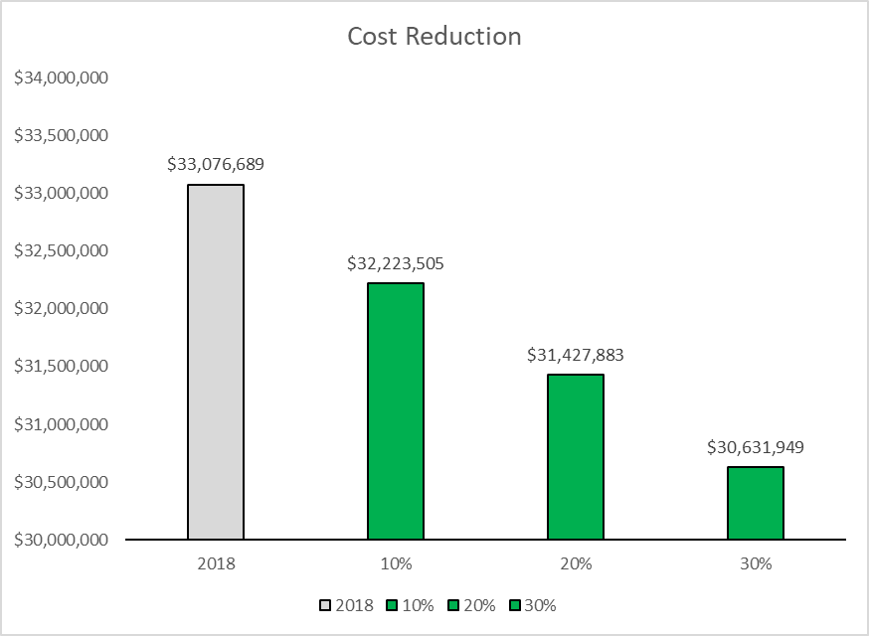
Modeling Results (Strategy 2)
2018 Cost ≈ $33,100,000
Assuming Lariat replaces 20% of the fleet:
2019 Cost Reduction ≈ $1,600,000
Cost Reduction Rate
≈ 5%
2018
(Baseline)
10%
20%
30%
Percent of Fleet to Replace

Slide 6
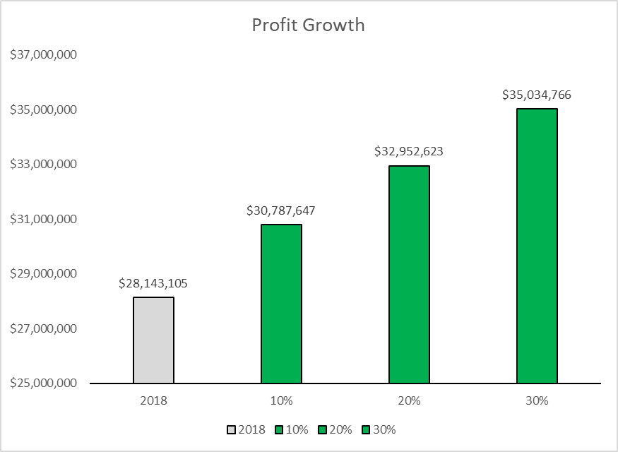
Modeling Results (Strategy 3)
2018 Profit ≈ $28,100,000
Assuming Lariat replaces 20% of the fleet:
2019 Additional Profit ≈ $4,800,000
Profit Growth Rate
≈ 17%
2018
(Baseline)
10%
20%
30%
Percent of Fleet to Replace

Slide 7
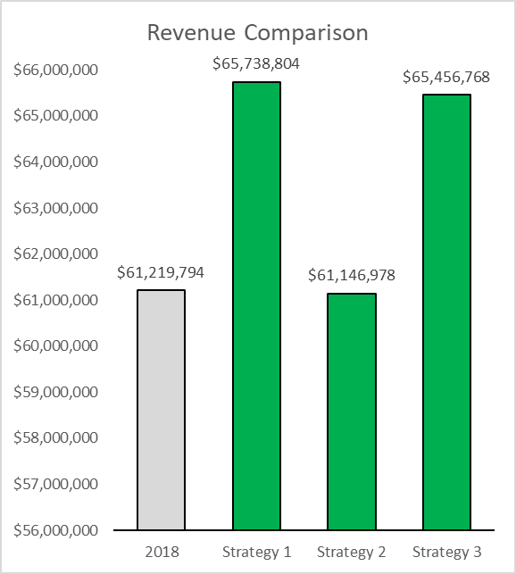
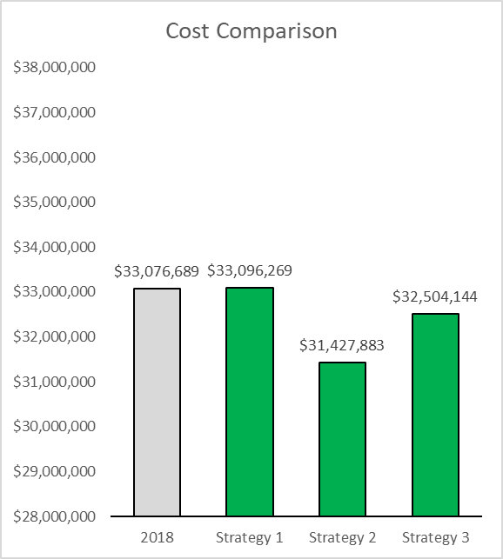
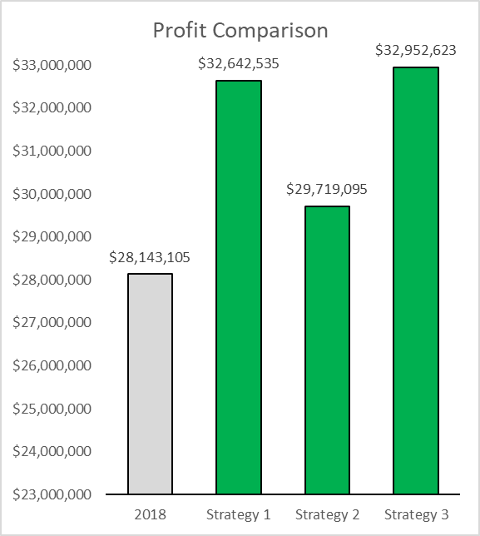
A Comparison of Strategies
All comparisons are reflective of 20% fleet replacement.

Slide 8
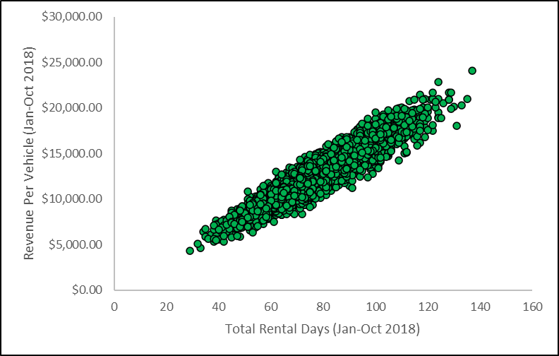
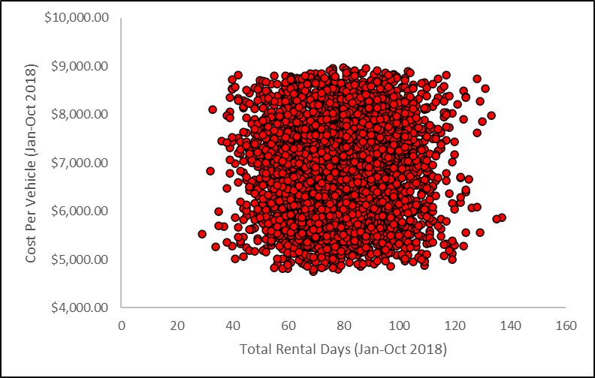
Give the Customer What They Want
Recommendation: Heavier emphasis on growing revenue and profits rather than cutting costs.
Why?: 1) Greater financial impact.
2) Revenue has a strong relationship with demand.
3) Cost has a poor relationship with demand.
High Cost
Low Demand
High Cost
High Demand
Low Cost
Low Demand
Low Cost
High Demand

Slide 9
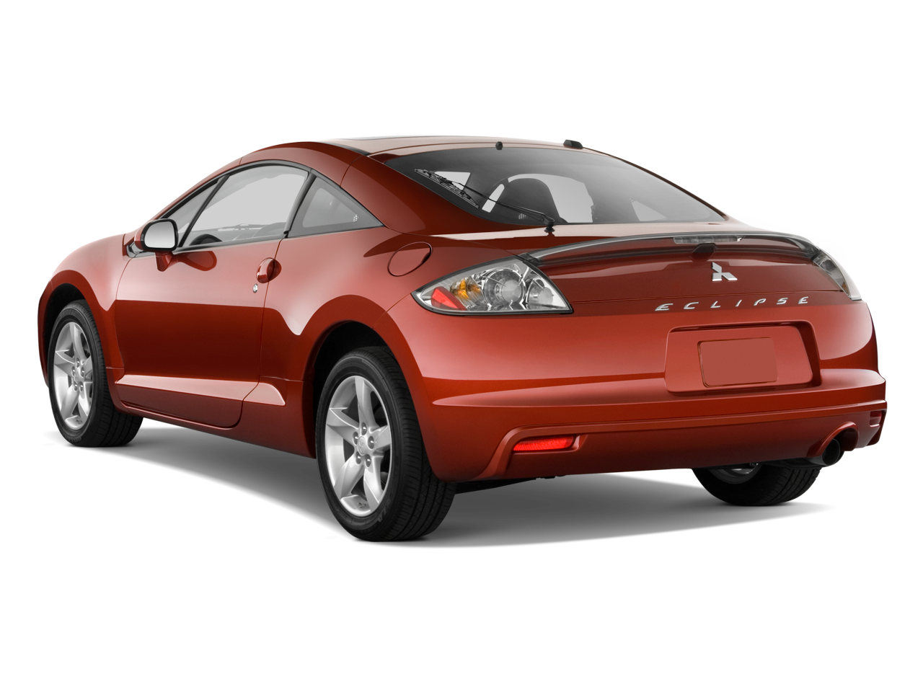
Sanity Check
Why not make an entire fleet of our highest earning vehicle?
Lack of fleet diversification could result in loss of customers.
Would strongly recommend setting a cap on percent of vehicles to replace. (No more than 20%)
2017 Mitsubishi Eclipse
This Photo by Unknown Author is licensed under CC BY-NC

Slide 10
Closing Thoughts
Recommend implementing Strategy 3 with a cap of 20% fleet replacement.
This analysis only focuses on vehicle replacement strategies that maintain a fleet count of 4000 vehicle.
Assumes a replacement revenue, cost, and profit per vehicle.
Other factors that could be taken into consideration:
-branch location
-proximity to an airport
-vehicle accidents
-driver gender and age

Slide 11
Supplemental Charts

Slide 12
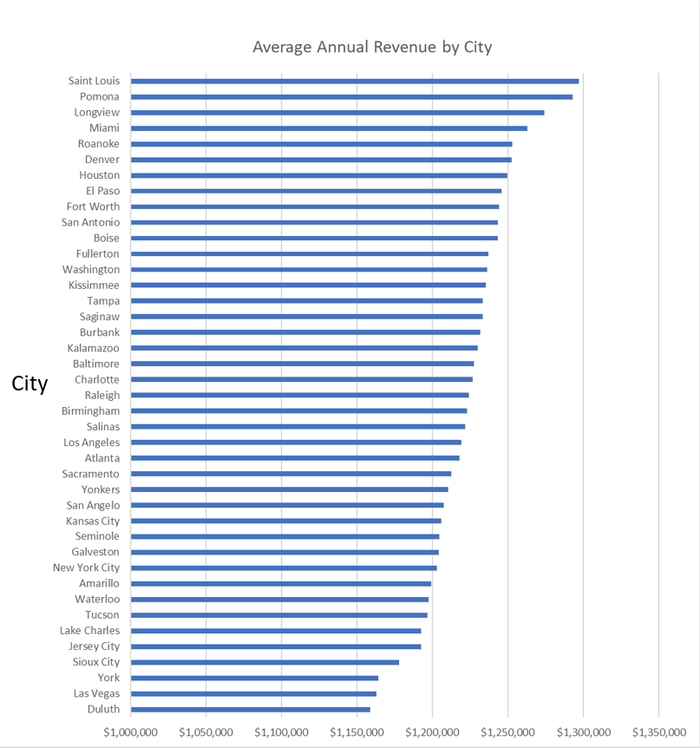
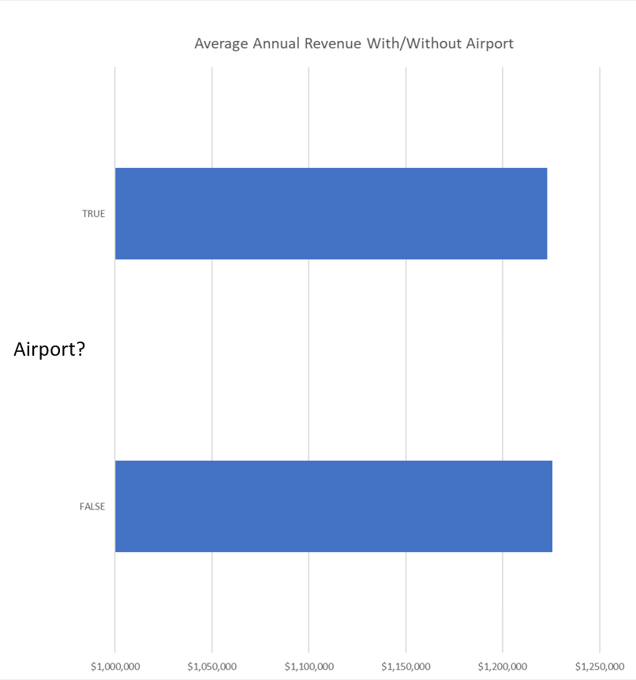
Impact of Branch Location
Impact of Airport

Slide 13
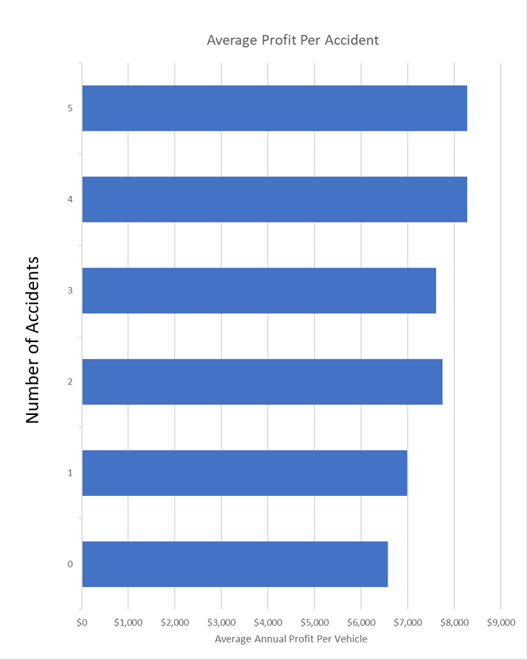
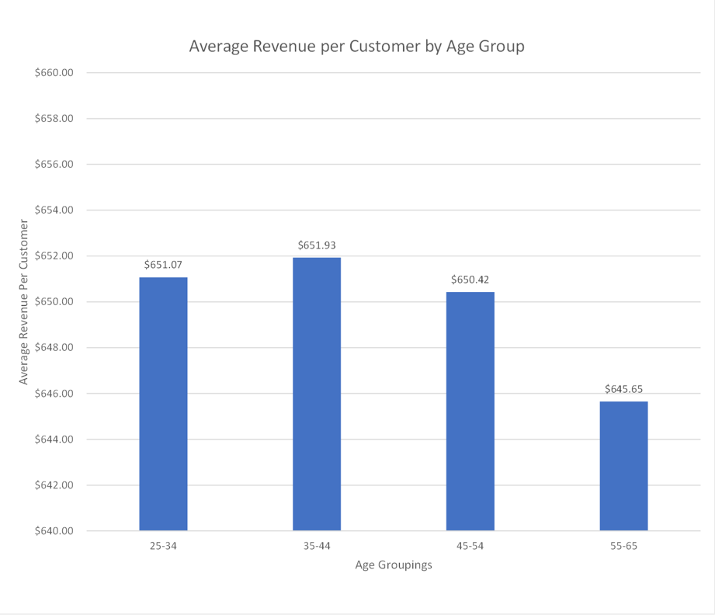
Impact of Accidents
Impact of Customer Age

